Slide 1
PROJECT PRESENTATION
Autonomous Mobile
Navigation Bot
using LiDAR Mapping
Sabiq RA2512053010005
Chandru RA2512053010012
Nedungkilli RA2512053010007
Vignesh RA2512053010010

Slide 2
Introduction
Autonomous mobile robots navigate without human intervention, using sensors and algorithms to perceive their surroundings.
A major challenge is operating in unknown environments without prior maps.
Simultaneous Localization and Mapping (SLAM) enables real-time map building while tracking position.
LiDAR and ultrasonic sensors play a key role in environment sensing and obstacle detection.
This project implements SLAM using ROS, optimizing sensor usage for efficient autonomous navigation.

Slide 3
Abstract
This project develops an autonomous mobile robot capable of navigating its environment without human control. The core goal is achieving Simultaneous Localization and Mapping (SLAM) using ROS — enabling the robot to build a map and track its position simultaneously.
A YDLIDAR X2 sensor provides 360° scanning, while ultrasonic sensors handle short-distance obstacle detection. Due to the Raspberry Pi's limited processing power, a laptop serves as the main computation unit via wireless communication.
An important focus is sensor optimization — varying sensor placement and count to study effective collision avoidance with minimal hardware.

Slide 4
Objectives
SLAM Implementation
01
Develop an autonomous mobile robot capable of performing Simultaneous Localization and Mapping (SLAM) using ROS for real-time mapping and navigation.
Sensor Optimization
02
Analyze different sensor placements and reduce the number of sensors while maintaining effective collision avoidance performance.

Slide 5
Components Used
Raspberry Pi 3 Model B
YDLIDAR X2 2D LiDAR
Ultrasonic Sensors HC-SR04
Motor Driver (L298N)
Onboard controller
360° environment scanning
2 units – short-range detection
Wheel drive control
4-Wheel Robotic Chassis
Li-ion Battery Pack
Laptop
With DC motors
Power supply unit
ROS master & SLAM processing

Slide 6
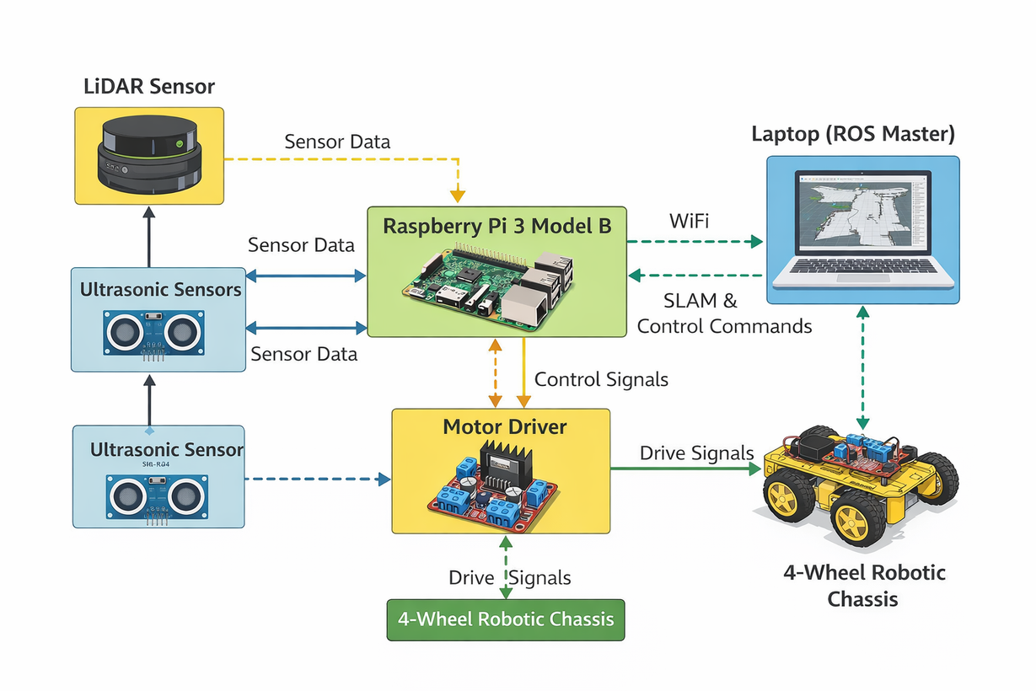
Methodology
1
2
Assemble hardware
Interface sensors with Raspberry Pi
3
4
Connect Pi & laptop via WiFi
Install & configure ROS
5
6
Acquire LiDAR & ultrasonic data
Implement SLAM
7
8
Generate map & localize
Obstacle avoidance & experiments

Slide 7
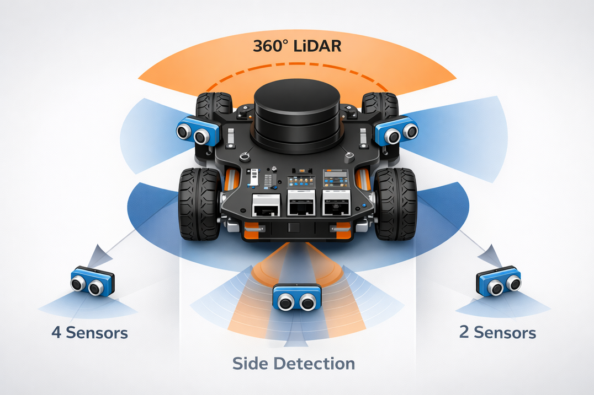
Sensor Optimization
Key Concept
Number Variation
Placement Analysis
Systematically vary the count of ultrasonic sensors to find the minimum required for reliable collision detection.
Test different sensor positions to determine optimal mounting configurations for full coverage and safety.
Trade-off Evaluation
Performance Threshold
Balance cost, power consumption, processing load, and safety margins across configurations.
Identify the minimal sensor set that meets collision-rate thresholds while preserving navigation performance.

Slide 8
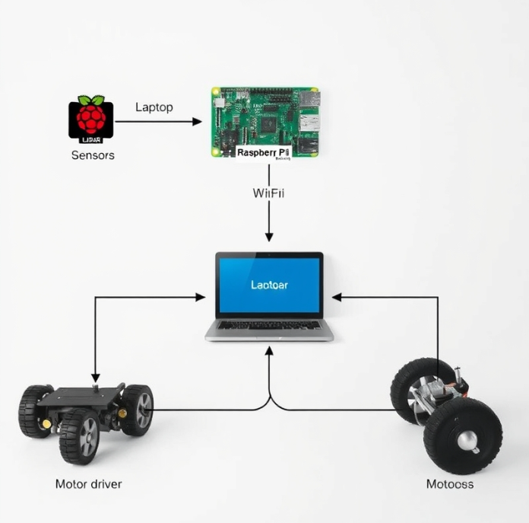
System Overview
Hardware Layer
Computation & Flow
▸ 4-Wheel chassis with DC motors + L298N motor driver
▸ Laptop runs ROS master + SLAM computation
▸ Raspberry Pi 3 Model B — onboard controller
▸ WiFi bridge: Pi node → Laptop ROS master
►
▸ YDLIDAR X2 — 360° environment scanning
▸ Path planning → actuator commands sent back
▸ Ultrasonic sensors — short-range obstacle detection
▸ GPU-accelerated processing where available
Sensors → Pi → WiFi → Laptop ROS → Path Planning → Motors

Slide 9
Progress Status
Step 1
Step 2
Step 3
Step 4
✓
✓
●
4
Buying
Components
Assembly
Working on ROS and programming
Final
Product
CURRENT

Slide 10
Current Progress
Progress Details
✓ Completed
⏳ Pending
✓ Hardware chassis fully assembled and calibration completed
Working on ROS and Programming
✓ Raspberry Pi configured
✓ Motor driver interfaced
✓ Ultrasonic sensors tested
✓ ROS installed and configured on laptop
✓ Successful communication established between Raspberry Pi and laptop

Slide 11
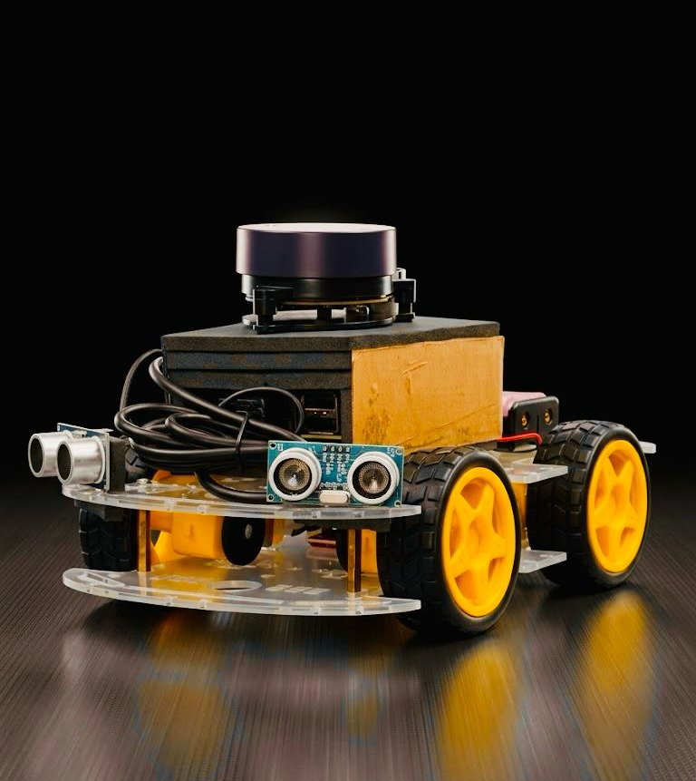
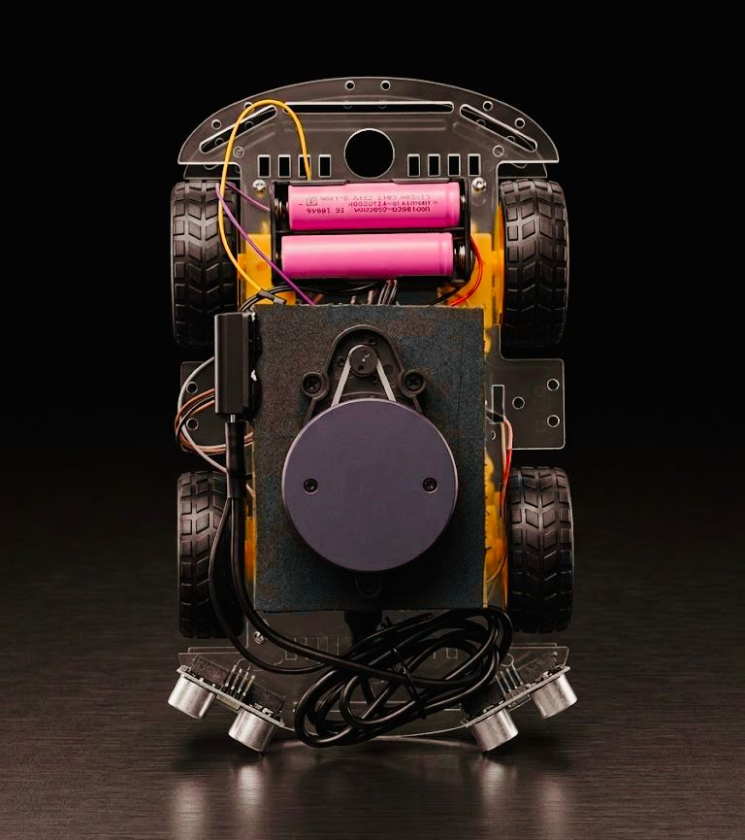
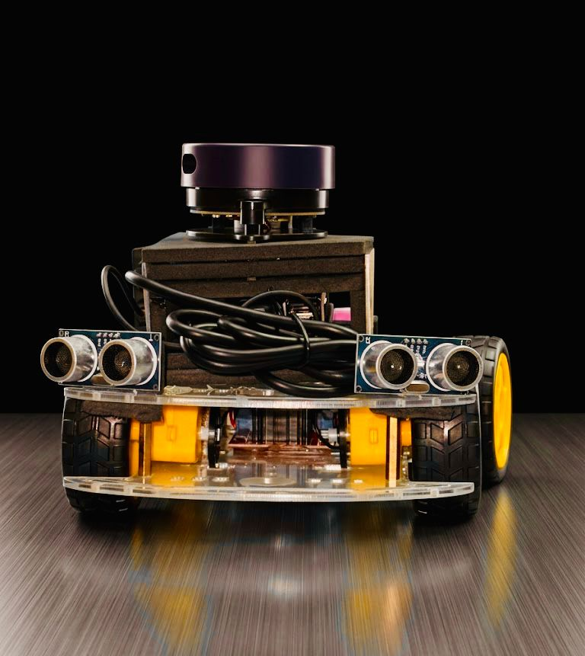
Robot Gallery
📷
📷
📷
[ Insert Photo ]
[ Insert Photo ]
[ Insert Photo ]
Original View
Top View
Front View

Slide 12
Contributors
Sabiq
Chandru
RA2512053010005
RA2512053010012
Programming & ROS
Hardware Assembly
Raspberry Pi programming and ROS configuration
Assembly of the robot project
Nedungkilli
Vignesh
RA2512053010007
RA2512053010010
Component Acquisition
Documentation
Component sourcing and presentation support
Presentation design and final report

Slide 13
Expected Results & Conclusions
🗺
Successful SLAM implementation for real-time mapping and localization
🛡
Effective obstacle detection and collision avoidance using LiDAR and ultrasonic sensors
📡
Reliable wireless communication between Raspberry Pi and laptop via ROS
⚡
Optimized sensor placement — reduced hardware with maintained navigation performance
💡
Demonstrates a cost-effective, efficient approach to autonomous mobile robotics

Slide 14
THANK YOU
Autonomous Mobile Navigation Bot using LiDAR Mapping
SLAM · ROS · LiDAR · Raspberry Pi

